Slide 1
Game Algorithms
GAM 1574
Dan Lingman
lingmad@algonquincollege.com
https://www.facebook.com/Dan.Lingman
https://www.linkedin.com/pub/dan-lingman/1/51a/300
https://twitter.com/Lingman
dlingman@gmail.com

Slide 2
Racing 101
Physics of racing and when to toss the rules out the window
Optimal path line
Slot car racing
Why have multiple paths when one is best?
Using Catmull-Rom to generate optimal path (including turning instructions)

Slide 3
Racing 101
Simple Racing AI
Slot Car AI
Multipath AI
Keeping it fun
AI "Optimizations" aka cheating
Hands on
Code walkthrough of getting Single track computer-controlled slot car racing working

Slide 4
Physics of racing
The physics of a race care can be as complicated as you want, taking into account things like tire wear, remaining fuel, weight transfer, transmission characteristics, and airflow.
Underneath it all, is a combination of forces acting to propel the vehicle along a path, or to try to keep it from moving (such as friction).

Slide 5
Physics of racing
Let's look at an object that is stationary, and apply a force to it in a forward direction.
The first force we need is traction - this is delivered by the torque of the rotating wheels.
Apply more engine power, and a higher forward force is applied.
F_{traction} = u * EngineForce (u is a unit vector in the direction the car is heading.)

Slide 6
Physics of racing
That's great, but without something to stop us, we could accelerate infinitely, and this obviously does not happen. We have two primary opposing forces - drag from air resistance and rolling resistance.
Air resistance depends on the square of the velocity, so it has a bigger impact.
F_{drag} = -C_{drag} * v * |V|
C_{drag} is a constant that is dependent on the car.

Slide 7
Physics of racing
Rolling resistance is caused by friction between the wheels and the road.
F_{rr} = -C_{rr} * v
C_{rr} is a constant that is dependent on the surface of the road and the properties of the wheels.
At low speeds, rolling resistance is the strongest. At high speeds the squared velocity in the drag equation takes precedence.

Slide 8
Physics of racing
In the end, the net force forward is:
F_{forward} = F_{traction} + F_{drag} + F_{rr}
Note that the drag and rolling resistance are in opposite directions to the traction.
Acceleration is force divided by mass:
a = F/M
a_{forward} = F_{forward}/M

Slide 9
Physics of racing
To accurately determine velocity, we need to integrate acceleration over time. This is hard, so we use the Euler method to get close enough:
v_{new} = v_{old} + Δt * a
(Δt is delta time)
Similarly position can be found by:
p_{new} = p_{old} + Δt * v

Slide 10
Physics of racing
The two constants - C_{drag} and C_{rr} - where do they come from?
In the real world, these can be determined by wind speed and road tests.
In your game, these will depend on the realism of the physics you want.
For a Corvette, C_{drag} is about 0.42 and C_{rr} is about 12.8

Slide 11
Physics of racing
Braking is effectively another force similar to the traction force, just in the opposite direction.
Just remember that if you continue to apply the braking force, you need to stop when your velocity is zero, or your car will suddenly start moving backwards.
Turning is a whole different can of worms, with different math for low and high-speed turns.

Slide 12
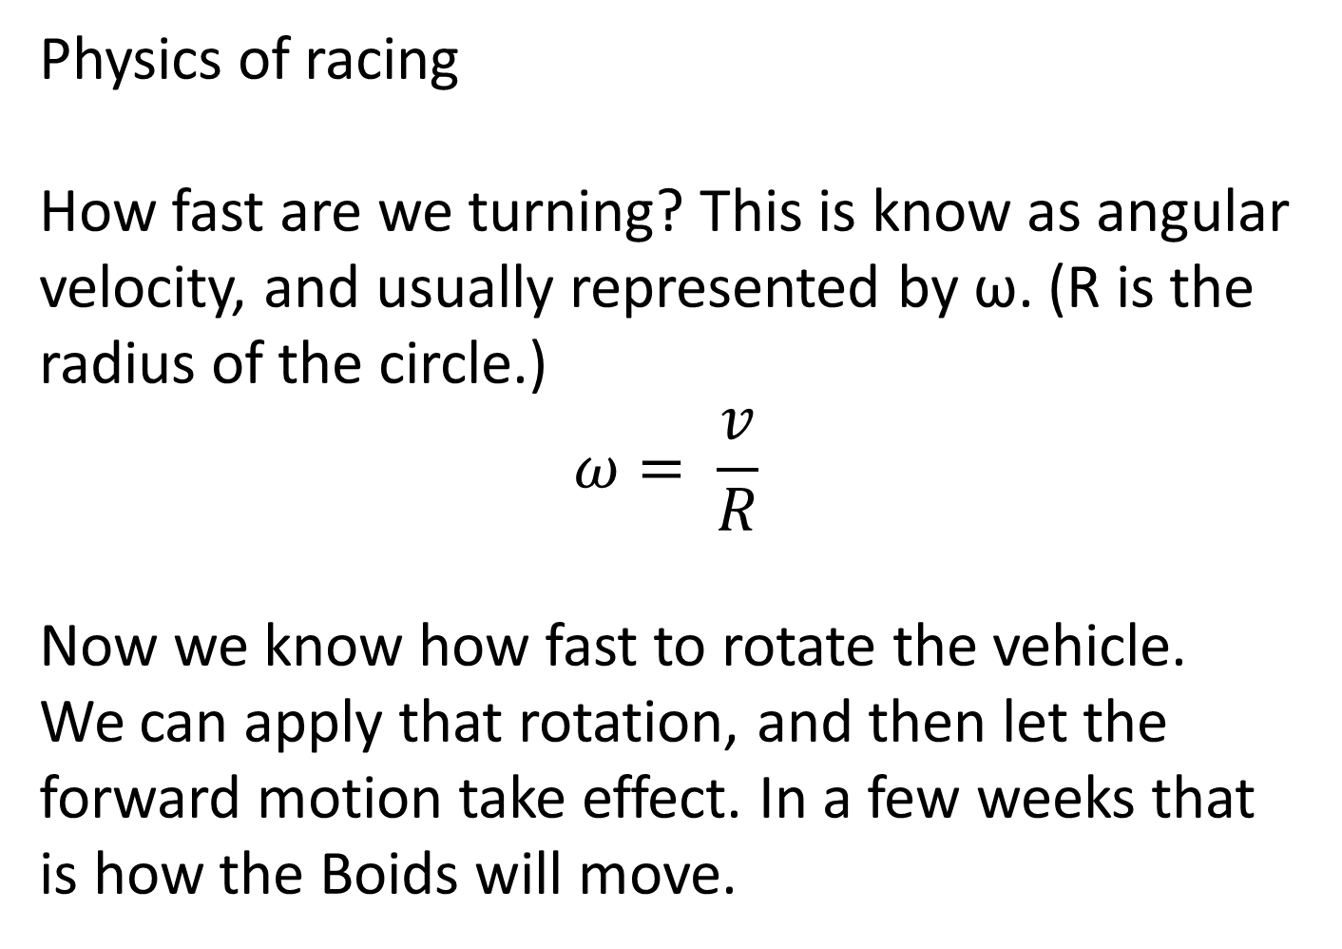
Physics of racing
How fast are we turning? This is know as angular velocity, and usually represented by ω. (R is the radius of the circle.)
$$ω= \frac{v}{R}$$
Now we know how fast to rotate the vehicle. We can apply that rotation, and then let the forward motion take effect. In a few weeks that is how the Boids will move.

Slide 13

Physics of racing
Low speed turns
Here we can see the front
tire turned to the left.
L is the wheelbase - the distance between the front and rear tires.
δ is the angle the front tires are turned at.
R is the turning radius, which we find thusly:
$$\sin\left(δ\right)= \frac{L}{R} ↔ R= \frac{L}{sin⁡(δ)}$$
δ
90°-δ
R
L
δ

Slide 14
Physics of racing
At high speeds, friction forces acting on the tires become much more complicated.
Tires roll easily forwards and backwards. They don't like going sideways.
You need to involve sideslip angles, the angular rotation of the entire car, and the steering angle of the front wheels.

Slide 15
Physics of racing
This rapidly devolves to a lot of trig, when what we really want is to know how much to turn the car.
We can approximate the force via
F_{lateral} = C_{a} * alpha
Where Ca is the cornering stiffness, and alpha is the slip angle.
Fortunately, Unity can help with applying forces.

Slide 16
Physics of racing
If we look at our picture
here, we can see that we
effectively want to apply a
force to the front of the
car (as a rigidbody) through the line from the front tire towards the centre of the turn.
This force is proportional to our velocity and the inertia of the car.
δ
90°-δ
R
L
δ

Slide 17
Physics of racing
So how can Unity help?
If your car has a Rigidbody attached to it, get that component, then use AddForceAtPosition where the wheels are to effectively turn the vehicle at that point.
You can also apply a relative torque to the rigidbody to cause rotation as well.

Slide 18
Physics of racing
public float torque;
public Rigidbody rb;
void Start()
{
rb = GetComponent<Rigidbody>();
}
void FixedUpdate()
{
float turn = Input.GetAxis("Horizontal");
rb.AddRelativeTorque(Vector3.up * torque * turn);
}

Slide 19
Physics of racing
When to break the laws of physics.
When they are interfering with your fun.
When they don't apply in your racing sim.
Think about a race game like Mario Kart. Would it be the same if you were not hit with stuff that makes you spin out temporarily?
(Apply relative torque is you friend for that.)

Slide 20
Path lines
A path line (also known as a racing line, or simply "the line") is an optimal route that a vehicle will take when going through a corner.
Surprisingly, this is NOT the inside corner. You simply have to decelerate too much to make the tight corner. It’s also not the outside corner, which, while it does have a bigger radius, isn’t good enough.

Slide 21
Path lines
What you want is actually a path that starts turning at the outside edge, touches the inner edge at 45 degrees, and then touches the outer path at the completion of the turn.
The picture on the next slide is from:
https://www.miata.net/sport/Physics/05-Cornering.html

Slide 22
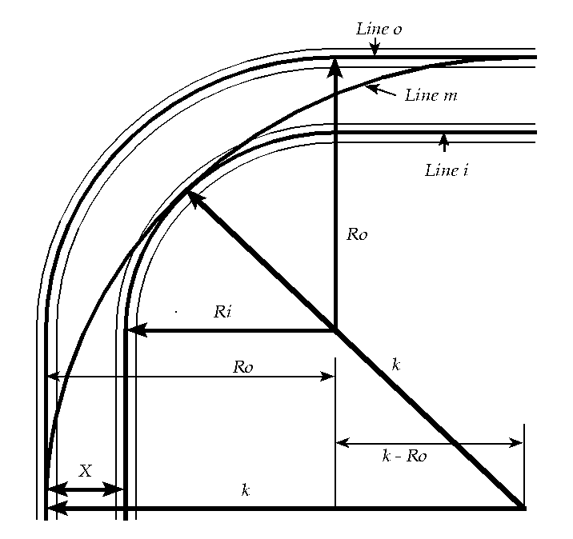
Path lines

Slide 23
Path lines
R_{o} is the outer radius
R_{i} is the inner radius
K is the radius of the line
R_{o} - R_{i} is the width of the track
K can be found via a pile of math
If we drop a line from where the diagonal reaches R_{i}, then trig tells us that it is 0.707 away from where the R_{o} and R_{i} lines meet.
This point is R_{o}-0.707R_{i} away from the vertical.

Slide 24
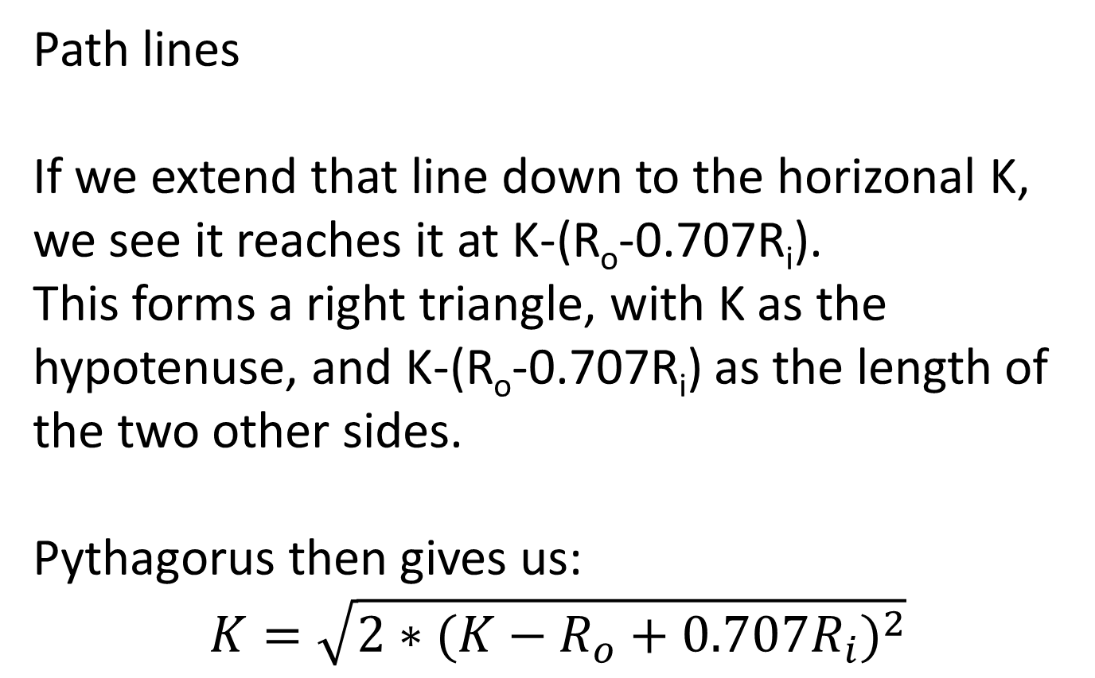
Path lines
If we extend that line down to the horizonal K, we see it reaches it at K-(R_{o}-0.707R_{i}).
This forms a right triangle, with K as the hypotenuse, and K-(R_{o}-0.707R_{i}) as the length of the two other sides.
Pythagorus then gives us:
$$K=\sqrt{2∗{(K−R_{o}+0.707R_{i})}^{2}}$$

Slide 25
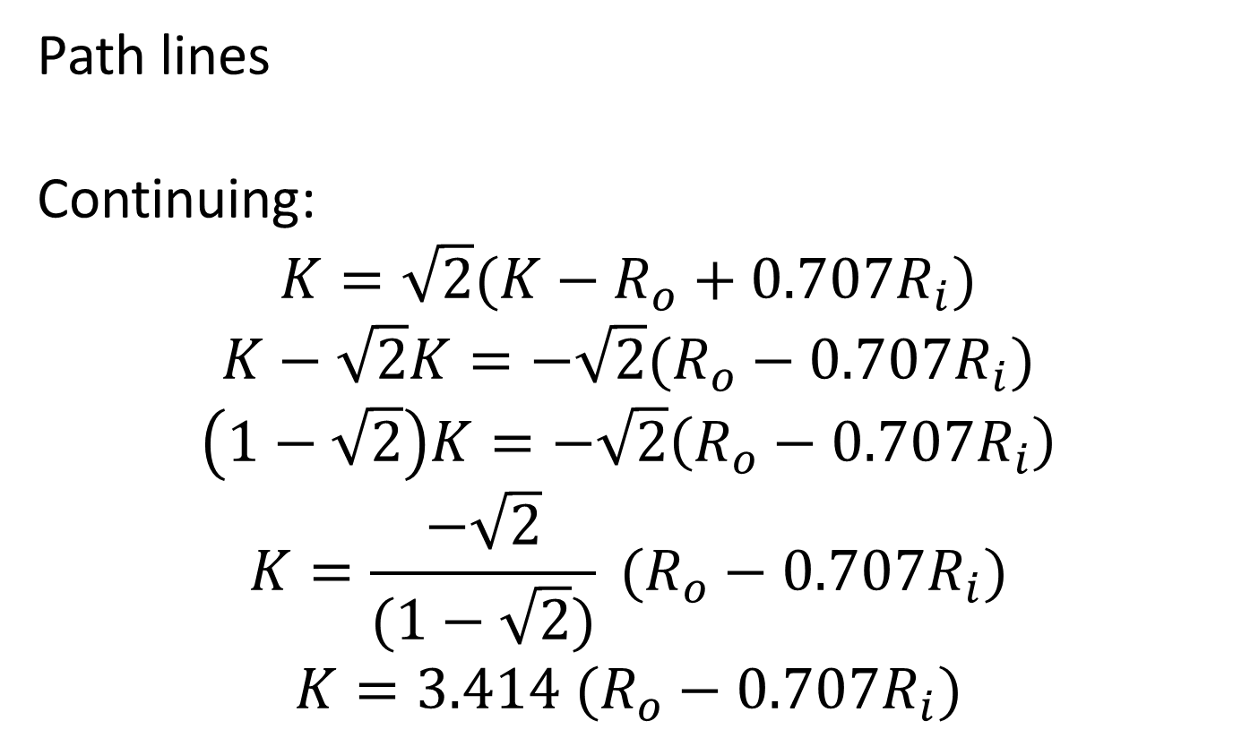
Path lines
Continuing:
$$K=\sqrt{2}(K−R_{o}+0.707R_{i})$$
$$K−\sqrt{2}K=−\sqrt{2}(R_{o}−0.707R_{i})$$
$$\left(1−\sqrt{2}\right)K=−\sqrt{2}\left(R_{o}−0.707R_{i}\right)$$
$$K=\frac{−\sqrt{2}}{(1−\sqrt{2})} (R_{o}−0.707R_{i})$$
$$K=3.414 (R_{o}−0.707R_{i})$$

Slide 26
Path lines
That's - a lot of math.
What it tells us is the best path and turn radius for the turn to get us through that corner as quickly as possible.
The whole idea is to minimize the angle of the corner, because maximum driving speed increases as the square root of the radius.

Slide 27
Path lines and generating racing tracks
This depends a lot on what you're trying to do.
Slot car - have the track centered on your spline, since steering is nonexistent anyways.
Real racing - I'd suggest start with your spline - this gives you your optimal path.
Then decide where to put the track based on how close to the waypoints you are.

Slide 28
Path lines and generating racing tracks
At the waypoint, you want the inner side of the track to line up with the waypoint.
At the midway point between waypoints, have the track centered on the spline.
At the 25% point, you want the outer side of the track lined up with the spline. Everything else is a linear interpolation between these extremes.

Slide 29
Path lines and generating racing tracks
How do you know where the inside and outside are?
Look at the control points on either side.
Connect a line between them, and compute the direction vector from that line to the middle waypoint. That vector points from the inside to the outside. If the vector has length 0, then you have three control points in a row.

Slide 30
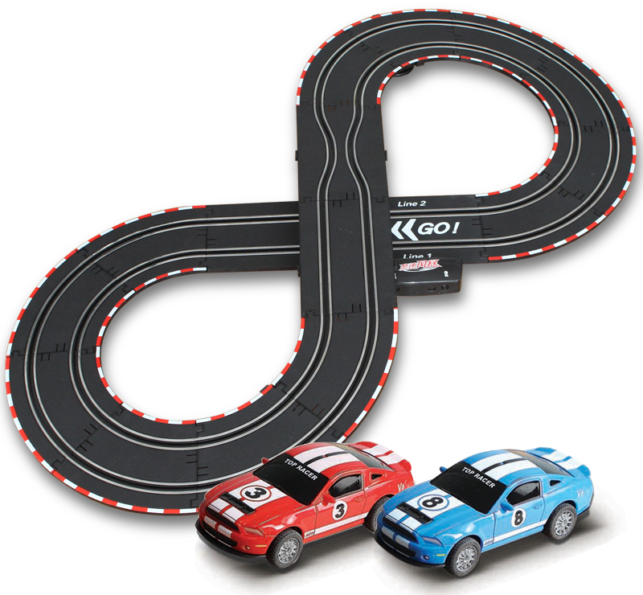
Slot car racing
What we had before RC cars and drones were everywhere. With a figure 8 track, you each had and inner and an outer loop, so the track lengths were the same. The
narrowing of the gap
made it interesting,
because if both cars
made it there at once
you'd collide.
Only speed could be adjusted.

Slide 31
Slot car racing
Speed on the corners was what made racing fun. Go too slow, and the other player will get ahead of you. Go to fast, and your car will fly off the track at the corner.
Yes, there are a number of video game versions of these out there, on Steam, mobile, and consoles.

Slide 32
Slot car racing
Getting slot car racing up and going is reasonably straightforward and will be at the heart of much of the rest of the course.
Let's consider a very, very simple track - one way, with three waypoints on it.

Slide 33
Slot car racing
The player varies the speed, making the car move forward at a different rate. When it reaches the corner, some math is needed.
The physics of the car control how fast it can turn for a given speed.

Slide 34
Slot car racing
Consider a short period of time (dt), such as that between two frames of your game. In that time, if we are going around a corner, we'll move forward a distance dx and sideways a distance ds.
If we want to stick to the corner perfectly, around a circle or radius r, then we must also go sideways by the same distance that we travel forward.

Slide 35
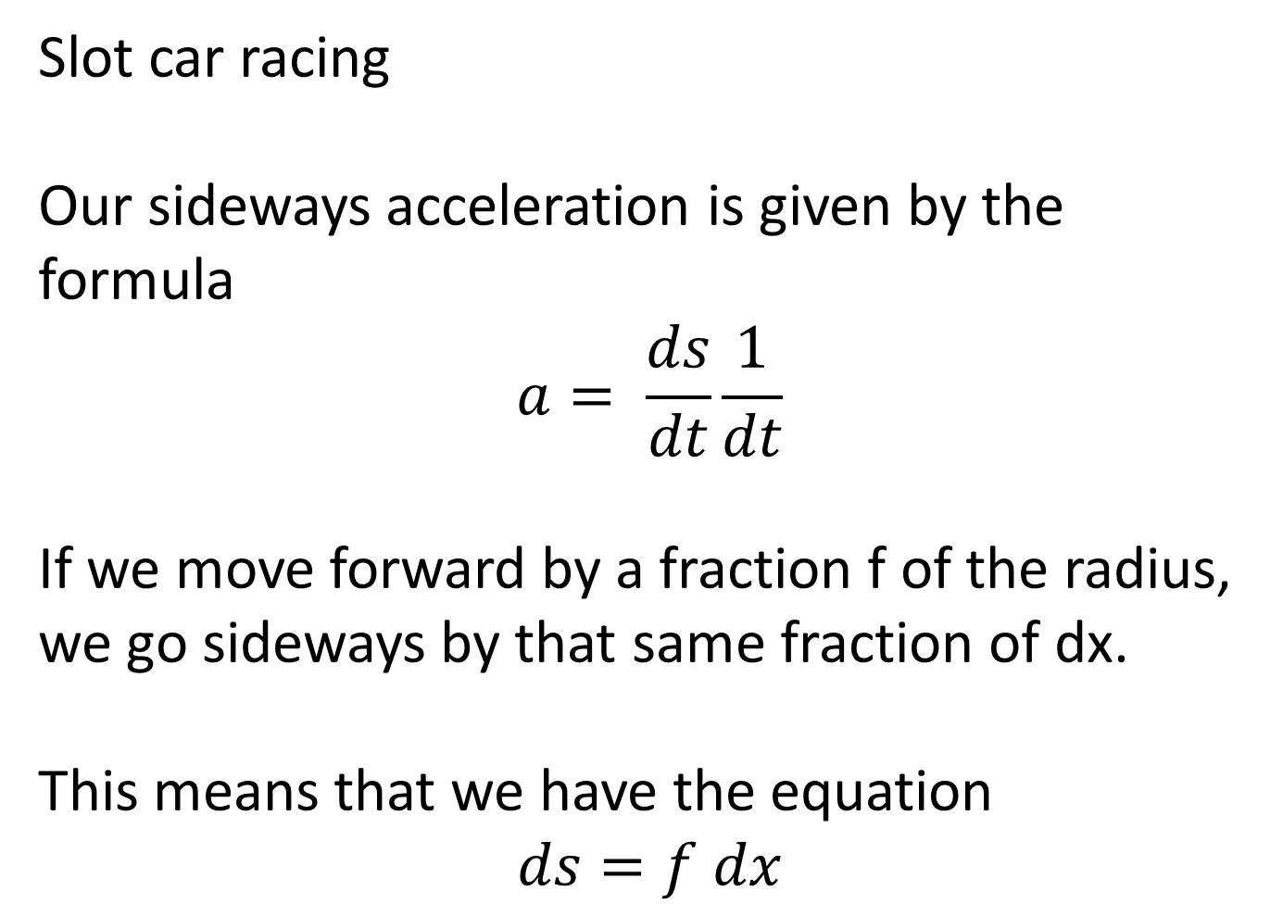
Slot car racing
Our sideways acceleration is given by the formula
$$a= \frac{ds}{dt}\frac{1}{dt}$$
If we move forward by a fraction f of the radius, we go sideways by that same fraction of dx.
This means that we have the equation
$$ds=f dx$$

Slide 36

Slot car racing
But
$$f= \frac{dx}{r}$$
From this, we get
$$ds=dx\frac{dx}{r}$$
Remembering that
$$v=\frac{dx}{dt}$$
This leads us to:

Slide 37
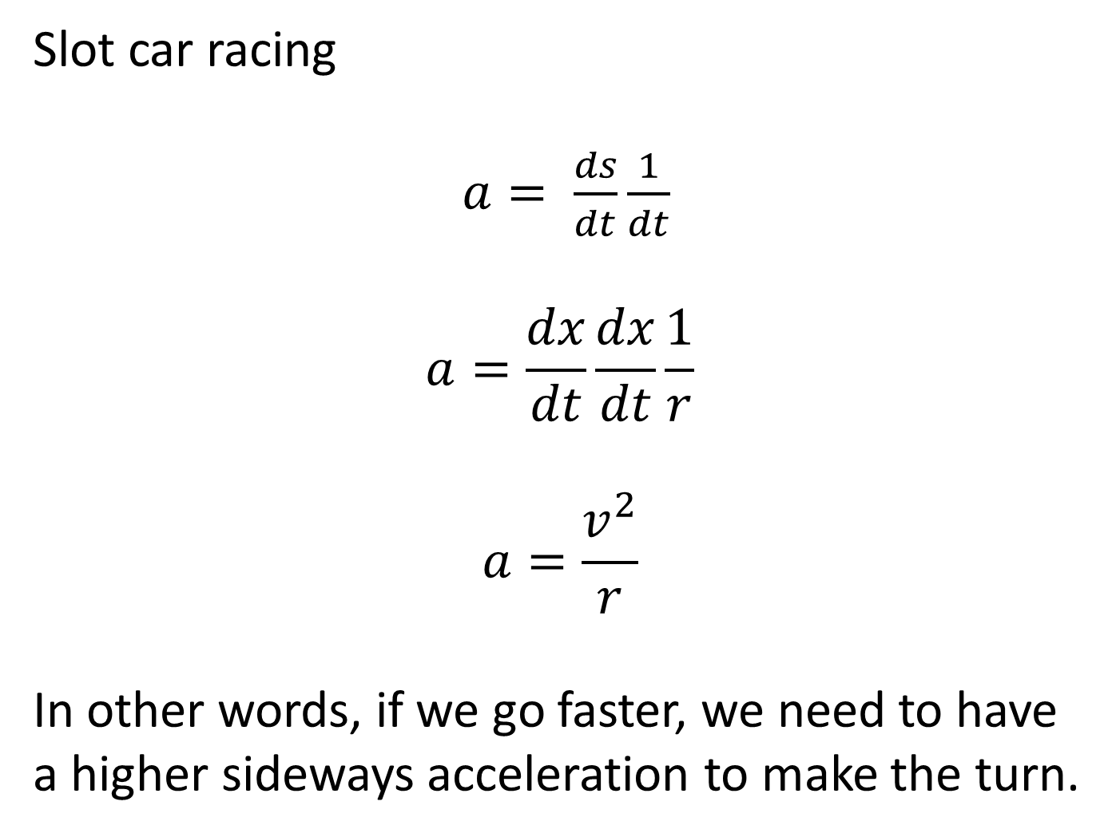
Slot car racing
$a= \frac{ds}{dt}\frac{1}{dt}$
$$a=\frac{dx}{dt}\frac{dx}{dt}\frac{1}{r}$$
$$a=\frac{v^{2}}{r}$$
In other words, if we go faster, we need to have a higher sideways acceleration to make the turn.

Slide 38
Slot car racing
The sideways acceleration for a car depends entirely on the friction between the car and the road.
Go too fast, and your tires will start to skid. In the case of a slot car, skidding means you are leaving the track.

Slide 39
Slot car racing - Simulating this in your game
If you recall, we can determine the angle between where we are, and where we want to go based on the points along our curve. This gives us an angle we need to rotate along based purely on our speed.
If we feed our velocity (and the radius of our curve in) we can determine the sideways acceleration we'd need to reach to make that curve.
If this is faster than the specs for our car, boom.

Slide 40
Car racing - Multiple tracks
A question arises - if we know what the optimal path to follow on a racetrack is, why bother with alternate paths? Because we're not doing a conga line simulator.
When you get to your corner, at a good speed and good turning rate, what should happen if someone is in front of you, and too slow? You steer around them, probably braking as you do so in order not to splatter yourself on the turn.

Slide 41
Car racing - Multiple tracks
Since your vehicles are designed to follow a series of waypoints, the easiest way to steer them around obstacles is to have them select a new track that will bypass the current problem.
Think of this as changing lanes on the highway.

Slide 42
Keeping it fun
Remember, you're building a game. Games are supposed to be fun. Don't feel bad about bending the laws of physics to make sure your game remains fun. Odds are you're not working on the next Forza at the moment. (If you are, then you need to do a LOT more reading up on the physics of driving.)

Slide 43
Keeping it fun - but doable CheatingAI?
Sometimes, it's ok to cheat in your game. It's not ok to get caught doing so.
Here's an example:
If an NPC racecar has left the track, it might have to do some serious steering to get back heading in the right direction. If the player can see the car, then this can't really be avoided.

Slide 44
Keeping it fun - but doable CheatingAI?
But what if they can't? Set the car back onto the track, pointing in the right direction, and start it back up again. Much simpler, and it works.
Another example is when the player is getting crushed. That's not fun. Trust me, your player KNOWS they are not good at driving their simulated car. Don't rub their noses in it. It's ok to dumb down the AI a bit to give them a chance of finishing reasonably.

Slide 45
Hands on
We're going to walk through some code that does single path slot car racing under computer control.
The camera will be locked behind and above the vehicle. Each time the vehicle passes the starting point, it's speed will be slightly increased until it eventually fails to make the turns.

Slide 46
Hands on
You're going to want to pay attention to how this works, as you'll need to build a human controllable. multi path version next week for your assignment.
Reminder - Next week has a test as well as that assignment. The test will start promptly at the beginning of class - get here, and get logged in. There will be no delay on the start time, and excuses won't grant you additional time.

